Slide 1

20CSD302 Mini Project Zeroth Review
SAINTGITS
COLLEGE OF ENGINEERING
(AUTONOMOUS)
LEARN . GROW . EXCEL

Slide 2
Project Area : Web Development Project Topic : OrderByte
SAINTGITS
COLLEGE OF ENGINEERING
(AUTONOMOUS)
Supervisor
Name: Er.Thomas Joseph
Designation: Assistant Professor
Presented By
Merlyn Mary Stephen - 23
Rinny Anna Thomas - 41
Shalin Ann Thomas - 53
Sneha Mariam Samuel - 61
LEARN . GROW . EXCEL

Slide 3

Contents
Introduction
Objectives
Literature review
Methodology
Project plan
Expected results
Current Status
LEARN . GROW . EXCEL

Slide 4
Introduction
OrderByte, is a web-based platform designed to:
Allow end users to preorder meals and make payments online, ensuring their selected meals are reserved and ready for collection.
Enhance the food service experience by eliminating the need to wait in long queues, making the process more efficient and convenient.
LEARN . GROW . EXCEL

Slide 5
Objectives
Reduce Canteen Congestion and Decrease Waiting Times by implementing a system for preordering and online payments.
Ensure Meal Availability for end users through advanced prebooking options.
Provide a User-Friendly Online Ordering Platform for seamless meal selection and payment.
Enhance Canteen Service Efficiency by enabling staff to prepare meals ahead of time.
Offer Support to Parents and Visitors with an effortless meal ordering process during college visits.
Encourage the Adoption of Digital Payment Solutions to optimize the ordering and payment system.
LEARN . GROW . EXCEL

Slide 6
Literature Review
Sl.No | Title | Authors & Publications | Techniques Used and Observations
1. | E-Canteen Management System based on Web Application | Lalitha V., Magesh K., Selvanarayanan A., Keertheshwaran G. | Introduces a web-based canteen management application. Enhances operational efficiency by streamlining order processing and transaction management. Reduces manual errors and waiting times in canteen queues.
2. | The Design of Nutrition Ordering System without Queuing in the College Canteen | Zhang X., Li Y., Wang J. | Proposes a nutrition-focused food ordering system. Aims to minimize queuing issues in college canteens. Provides an advanced web interface that allows students to customize their meal options based on nutritional requirements
LEARN . GROW . EXCEL

Slide 7
Literature Review
Sl.No | Title | Authors & Publications | Techniques Used and Observations
3. | The Website-Based Food Booking System Equipped with Real-Time Booking Status to Address Queuing Issues at Restaurants | M. R. Ardiansyah, J. F. Kusuma, I. S. Gumelar, M. Mentari | Implements a real-time booking system for food orders. Designed to address excessive queuing at restaurants, adaptable for canteen management. Features live booking status updates to ensure users know the availability of dishes.
4. | Canteen Automation System with Payment Gateway | Avhad P., Bhanushali H., Bhatt K., Rathod M. | Combines canteen management with automated payment systems. Provides integration with online payment gateways for seamless transactions. Aims to enhance customer convenience and reduce the scope for manual billing errors.
LEARN . GROW . EXCEL

Slide 8
Literature Review
Sl.No | Title | Authors & Publications | Techniques Used and Observations
5. | MERN-Based Canteen Management System: IoT Integration for RFID Payment and Table Reservation | Gosalia J., Dhande S., Naiksatam A. | Utilizes the MERN stack (MongoDB, Express.js, React.js, Node.js) for efficient system development. Integrates IoT devices for RFID-based payments, ensuring contactless transactions. Provides features like table reservations and pre-ordering to optimize user experience. Focuses on scalability and modular design for future enhancements.
LEARN . GROW . EXCEL

Slide 9
Methodology
Front-End Development: Utilizing HTML, CSS, and JavaScript, specifically frameworks like React or Angular, to construct a user-friendly and interactive interface.
Back-End Development: Employing Node.js or Python, through frameworks like Flask, to manage server-side processing and business logic.
Database: Implementing MySQL to store user information, order details, and menu information.
Version Control: Utilizing GitHub for effective code version management and collaborative development.
LEARN . GROW . EXCEL

Slide 10
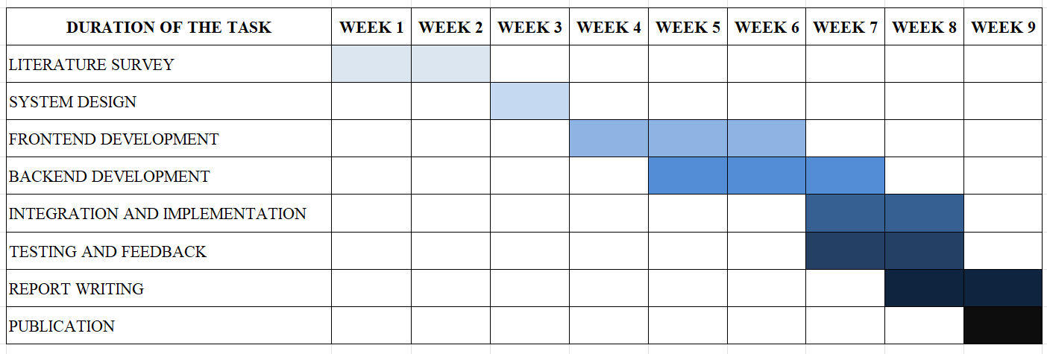
Project Plan
LEARN . GROW . EXCEL

Slide 11
Expected Result
The OrderByte is designed to decrease waiting periods and minimize canteen crowding by permitting users to preorder their meals and make payments online.
This system will enhance the canteen's operational efficiency by allowing the staff to prepare meals according to the preorders, thus, ensuring punctual and well-organized food service.
By facilitating advance bookings, the system guarantees the availability of preferred meals for end-users.
LEARN . GROW . EXCEL

Slide 12
Current Status
Literature Review and UI/UX design planning.
LEARN . GROW . EXCEL

Slide 13
References
Lalitha V., Magesh K., et al., "E-Canteen Management System," IC3IoT, IEEE, vol. 15, no. 4, pp. 45-50, Aug. 2022.
Zhang X., Li Y., Wang J., "Nutrition Ordering System," SmartTech J., IEEE, vol. 9, no. 2, pp. 20-25, Feb. 2020.
M. R. Ardiansyah, J. F. Kusuma, I. S. Gumelar, M. Mentari, "Website-Based Food Booking System," TechXplore, IEEE, vol. 12, no. 3, pp. 31-40, Mar. 2021.
Avhad P., Bhanushali H., Bhatt K., Rathod M., "Canteen Automation System," Int. J. Comput., IEEE, vol. 7, no. 1, pp. 12-19, Jan. 2022.
Gosalia J., Dhande S., Naiksatam A., "MERN-Based Canteen Management System," IoT & Cloud Comput., IEEE, vol. 13, no. 4, pp. 56-62, Dec. 2020.
LEARN . GROW . EXCEL

